Slide 1
MORE ON A* ALGORITHM AND GAME PLAYING
Unit III

Slide 2
Results related to Admissibility of A*
The heuristic function h(n) is referred to as acceptable, and it is always less than or equal to the actual cost, which is the true cost from the present point in the path.
H(n) is never bigger than h*(n) in this context. This has to do with the idea of reliable heuristics. All reliable heuristics can be used, however not all reliable heuristics can be used.

Slide 3
The evaluation function in A* looks like this: f(n) = g(n) + h(n) f(n) = Actual cost + Estimated cost here, n = current node. f(n) = evaluation function. g(n) = the cost from the initial node to the current node. h(n) = estimated cost from the current node to the goal state.

Slide 4
Key Points:
The heuristic function h(n) is admissible if h(n) is never larger than h*(n) or if h(n) is always less or equal to the true value.
If A* employs an admissible heuristic and h(goal)=0, then we can argue that A* is admissible.
If the heuristic function is constantly tuned to be low with respect to the true cost, i.e. h(n) ≤ h*(n), then you are going to get an optimal solution of 100%

Slide 5
Let’s suppose, you are going to purchase shoes and shoes have a price of $1000. Before making the purchase, you estimated that the shoes will be worth $1200, When you went to the store, the shopkeeper informed you that the shoe’s actual price was $1, 000, which is less than your estimated value, indicating that you had overestimated their value by $200. so this is the case of Overestimation.
1200 > 1000 i.e. h(n) ≥ h*(n) ∴ Overestimation

Slide 6
Space Saving Version of A*: Iterative Deepening A*
Iterative deepening A* (IDA*) is a graph traversal and path-finding method that can determine the shortest route in a weighted graph between a defined start node and any one of a group of goal nodes.
It is a kind of iterative deepening depth-first search that adopts the A* search algorithm’s idea of using a heuristic function to assess the remaining cost to reach the goal.
A memory-limited version of A* is called IDA*. It performs all operations that A* does and has optimal features for locating the shortest path, but it occupies less memory.
Iterative Deepening A Star uses a heuristic to choose which nodes to explore and at which depth to stop, as opposed to Iterative Deepening DFS, which utilizes simple depth to determine when to end the current iteration and continue with a higher depth.

Slide 7
The graph traversal algorithm.
Find the shortest path in a weighted graph between the start and goal nodes using the path search algorithm.
An alternative to the iterative depth-first search algorithm.
Uses a heuristic function, which is a technique taken from A* algorithm.
It’s a Depth-First Search algorithm, So it used less memory than the A* algorithm.
IDA* is an admissible heuristic because it never overestimates the cost of reaching the goal.
It’s focused on searching the most promising nodes, so, it doesn’t go to the same depth everywhere.

Slide 8

The evaluation function in IDA* looks like this:
Where h is admissible. here, f(n) = Total cost evaluation function. g(n) = The actual cost from the initial node to the current node. h(n) = Heuristic estimated cost from the current node to the goal state. it is based on the approximation according to the problem characteristics.

Slide 9
What is the f score?
In the IDA* algorithm, F-score is a heuristic function that is used to estimate the cost of reaching the goal state from a given state. It is a combination of two other heuristic functions, g(n) and h(n).
It is used to determine the order in which the algorithm expands nodes in the search tree and thus, it plays an important role in how quickly the algorithm finds a solution.
A lower F-score indicates that a node is closer to the goal state and will be expanded before a node with a higher F-score. Simply it is nothing but g(n) + h(n).

Slide 10
How IDA* algorithm work?
Step 1: Initialization
Set the root node as the current node, and find the f-score.
Sep 2: Set threshold
Set the cost limit as a threshold for a node i.e the maximum f-score allowed for that node for further explorations.
Step 3: Node Expansion
Expand the current node to its children and find f-scores.
Step 4: Pruning
If for any node the f-score > threshold, prune that node because it’s considered too expensive for that node and store it in the visited node list.
Step 5: Return Path
If the Goal node is found then return the path from the start node Goal node.
Step 6: Update the Threshold
If the Goal node is not found then repeat from step 2 by changing the threshold with the minimum pruned value from the visited node list. And Continue it until you reach the goal node.

Slide 11
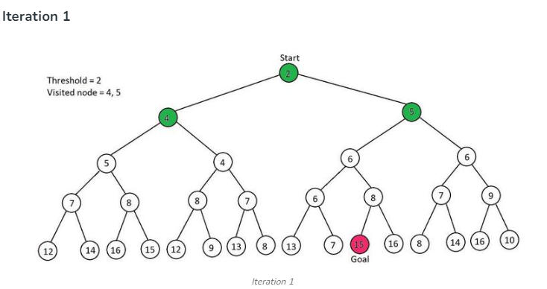
Example
In the below tree, the f score is written inside the nodes means the f score is already computed and the start node is 2 whereas the goal node is 15. the explored node is colored green color. so now we have to go to a given goal by using IDA* algorithm.
Root node as current node i.e 2
Threshold = current node value (2=2). So explore its children.
4 > Threshold & 5>Threshold. So, this iteration is over and the pruned values are 4, and 5.

Slide 12
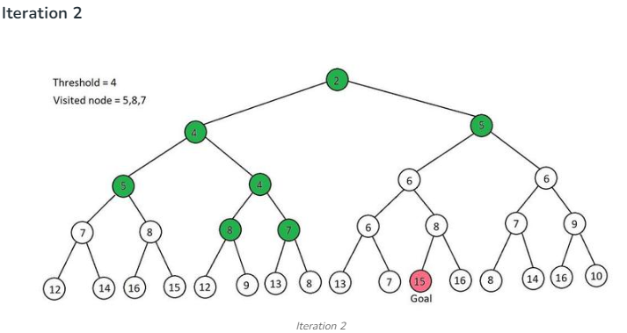
In pruned values, the least is 4, So threshold = 4
current node = 2 and 2< threshold, So explore its children. i.e two children explore one by one
So, first children 4, So, set current node = 4 i.e equal to the threshold, so, explored its children also i.e 5, 4 having 5> threshold so, pruned it and explore second child of node 4 i.e 4, so set current node = 4 = threshold, and explore its children i.e 8 & 7 having both 8 & 7 > threshold so, pruned it. At the end of this, our pruned value is 5,8,7
Similarly, Explore the second child of root node 2 i.e 5 as the current node, i.e 5>threshold, So pruned it.
So, our pruned value is 5,8,7.

Slide 13
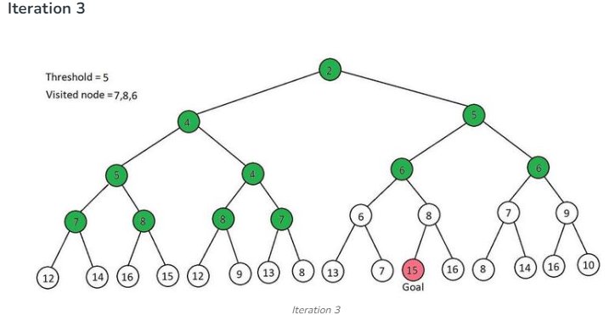
In pruned values, the least is 5, So threshold = 5
current node = root node = 2 and 2< threshold, So explore its children. i.e two children explore one by one
So, first children 4, So, set current node = 4 < threshold, so, explored its children also i.e 5, 4 having 5= threshold so explore its child also 7&8 > threshold. So, pruned it and explore the second child of node 4 i.e 4, so set current node = 4 < threshold, and explore its children i.e 8 & 7 here, both 8 & 7 > threshold so, pruned it. At the end of this, our pruned value is 7 & 8
Similarly, Explore the second child of root node 2 i.e 5 as the current node, i.e 5 = threshold, so, explored its children also i.e 6 & 6, i.e both 6 & 6 > threshold. So pruned it
So, our pruned value is 7,8 & 6

Slide 14
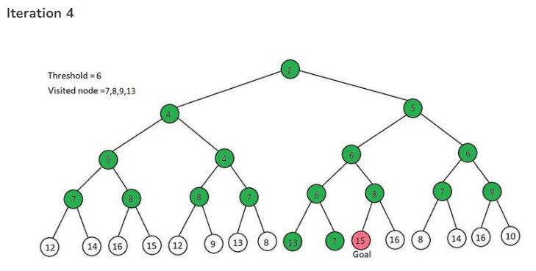
In pruned values, the least value is 6, So threshold = 6
current node = root node = 2 and 2< threshold, So explore its children. i.e two children explore one by one
So, the first child is 4, So, set current node = 4 < threshold, so, explored its children also i.e 5, 4 having 5< threshold so explore its child also 7&8 > threshold. So, pruned it and explore the second child of node 4 i.e 4, so set current node = 4 < threshold, and explore its children i.e 8 & 7 here, both 8 & 7 > threshold so, pruned it. At the end of this, our pruned value is 7 & 8
Similarly, Explore the second child of root node 2 i.e 5 as the current node, i.e 5 = threshold, so, explored its children also i.e 6 & 6, i.e both 6 & 6 = threshold, So, explore one by one,
The first 6 has two children i.e 6 & 8, having 6 = threshold. So, explore its child also i.e 13 & 7. here both 13 & 7 > Threshold. So, pruned it. next is 8 > Threshold. pruned it, So, pruned value at this stage is 13,7 & 8.
Explore the second child of 5 i.e 6 = Threshold. So, explore its child i.e 7 & 9. Both are greater than Threshold. So, pruned it
So, our pruned values are 13,7,8 & 9.

Slide 15
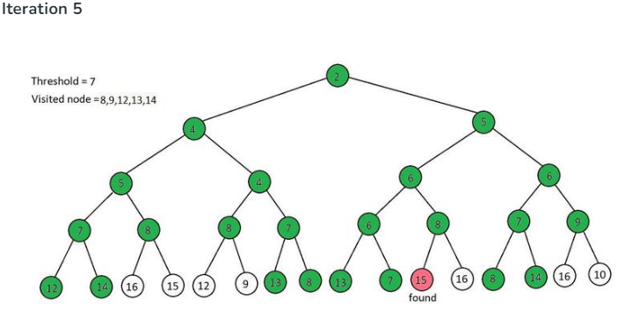
In pruned values, the least value is 7, So threshold = 7
current node = root node = 2 and 2< threshold, So explore its children. i.e two children explore one by one
So, the first child is 4, So, set current node = 4 < threshold, so, explored its children also i.e 5, 4
The first child of 4 is 5 i.e 5< threshold so explore its child also 7&8, Here 7 = threshold. So, explore its children i.e 12 & 14, both > Threshold. So, pruned it. And the second child of 5 is 8 > Threshold, So, pruned it. At this stage, our pruned value is 12, 14 & 7.
Now explore the second child of node 4 i.e 4, so set current node = 4 < threshold, and explore its children i.e 8 & 7 here, 8 > threshold so, pruned it. then go to the second child i.e 7 = Threshold, So explore its children i.e 13 & 8. having both > Threshold. So pruned it. At the end of this, our pruned value is 12,14,8 & 13
Similarly, Explore the second child of root node 2 i.e 5 as the current node, i.e 5 < threshold, so, explored its children also i.e 6 & 6, i.e both 6 & 6 < threshold, So, explore one by one,
The first 6 has two children i.e 6 & 8, having 6 < threshold. So, explore its child also i.e 13 & 7. here 13 > Threshold. So, pruned it. And 7= Threshold. And it hasn’t any child. So, the shift to the next sub-child of 6 i.e 8 > threshold, So, pruned it. The pruned value at this stage is 12,14,8 &13
Explore the second child of 5 i.e 6 < Threshold. So, explore its child i.e 7 & 9. Here 7 = Threshold, So, explore its children i.e 8 & 14, Both are greater than Threshold. So, pruned it, Now the sub child of 6 is 9 > Threshold, So, pruned it.
So, our pruned values are 12,14,8,13 & 9.

Slide 16
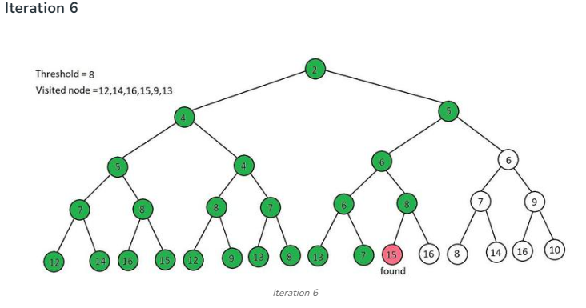

Slide 17
In pruned values, the least value is 8, So threshold = 8
current node = root node = 2 and 2< threshold, So explore its children. i.e two children explore one by one
So, the first child is 4, So, set current node = 4 < threshold, so, explored its children also i.e 5, 4
The first child of 4 is 5 i.e 5< threshold so explore its child also 7&8, Here 7 < threshold. So, explore its children i.e 12 & 14, both > Threshold. So, pruned it. And the second child of 5 is 8 = Threshold, So, So, explore its children i.e 16 & 15, both > Threshold. So, pruned it. At this stage, our pruned value is 12, 14, 16 & 15.
Now explore the second child of node 4 i.e 4, so set current node = 4 < threshold, and explore its children i.e 8 & 7 here, 8 = Threshold, So, So, explore its children i.e 12 & 9, both > Threshold.

Slide 18
So, pruned it. then go to the second child i.e 7 < Threshold, So explore its children i.e 13 & 8. having 13 > Threshold. So pruned it. and 8 = Threshold and it hasn’t any child. At the end of this, our pruned values are 12, 14, 16, 15, and 13.
Similarly, Explore the second child of root node 2 i.e 5 as the current node, i.e 5 < threshold, so, explored its children also i.e 6 & 6, i.e both 6 & 6 < threshold, So, explore one by one,
The first 6 has two children i.e 6 & 8, having 6 < threshold. So, explore its child also i.e 13 & 7. here 13 > Threshold. So, pruned it. And 7<Threshold. And it hasn’t any child. So, the shift to the next sub-child of 6 i.e 8 = threshold. So, explored its children also i.e 15 & 16, Here 15 = Goal Node. So, stop this iteration. Now no need to explore more.
The goal path is 2–>5–>6–>8–>15

Slide 19
Advantages
IDA* is guaranteed to find the optimal solution if one exists.
IDA* avoids the exponential time complexity of traditional Depth First Search by using an “iterative deepening” approach, where the search depth is gradually increased.
IDA* uses a limited amount of memory as compared to the A* algorithm because it uses Depth First Search.
IDA* is an admissible heuristic, it never overestimates the cost of reaching the goal.
It’s efficient in handling large numbers of states and large branch factors.

Slide 20
Disadvantages
Explore the visited node again and again. it doesn’t keep track of the visited nodes.
IDA* may be slower to get a solution than other search algorithms like A* or Breadth-First Search because it explores and repeats the explore node again and again.
It takes more time and power than the A* algorithm.

Slide 21
Game Playing: Board Games and Game Trees
Game Playing is an important domain of artificial intelligence. Games don’t require much knowledge; the only knowledge we need to provide is the rules, legal moves and the conditions of winning or losing the game.
Both players try to win the game. So, both of them try to make the best move possible at each turn. Searching techniques like BFS(Breadth First Search) are not accurate for this as the branching factor is very high, so searching will take a lot of time. So, we need another search procedures that improve –
Generate procedure so that only good moves are generated.
Test procedure so that the best move can be explored first.

Slide 22
There are two main approaches to game playing in AI, rule-based systems and machine learning-based systems.
Rule-based systems use a set of fixed rules to play the game.
Machine learning-based systems use algorithms to learn from experience and make decisions based on that experience.

Slide 23
Board games
Board games are one of the oldest branches of AI (Shannon and Turing 1950). Board games present a very abstract and pure form of competition between two opponents and clearly require a form of “intelligence”.
The states of a game are easy to represent.
The possible actions of the players are well-defined.
→ Realization of the game as a search problem
→ The individual states are fully accessible
→ It is a contingency problem, because the characteristics of the opponent are not known in advance.

Slide 24
Board games are not only difficult because they are contingency problems, but also because the search trees can become astronomically large.
Examples:
Chess: On average 35 possible actions from every position; often, games have 50 moves per player, resulting in a search depth of 100: → 35100 ≈ 10150 nodes in the search tree (with “only” 1040 legal chess positions).
Good game programs have the properties that they delete irrelevant branches of the game tree, use good evaluation functions for in-between states, and look ahead as many moves as possible.

Slide 25
Players are max and min, where max begins.
Initial position (e.g., board arrangement)
Operators (= legal moves)
Termination test, determines when the game is over.
Terminal state = game over.
In contrast to regular searches, where a path from beginning to end is simply a solution, max must come up with a strategy to reach a terminal state regardless of what min does → correcting reactions to all of min’s moves

Slide 26
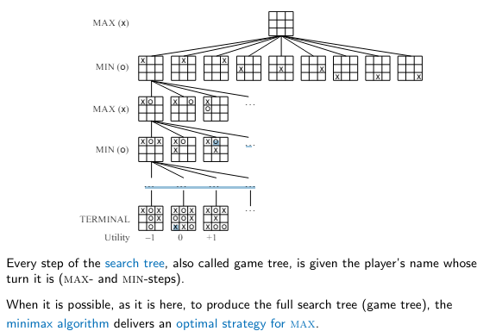

Slide 27
Game trees
Generalizing Search Problems
In these cases, we need to generalize our view of search to handle state changes that are not in the control of the agent.
One generalization yields game tree search agent and some other agents.
The other agents are acting to maximize their profits this might not have a positive effect on your profits.

Slide 28
Two-person, zero-sum games
chess, checkers, tic-tac-toe, backgammon, go, Doom, “find the last parking space”
Your winning means that your opponent looses, and vice-versa.
Zero-sum means the sum of your and your opponent’s payoff is zero---any thing you gain come at your opponent’s cost (and vice-versa).
Key insight: how you act depends on how the other agent acts (or how you think they will act) and vice versa (if your opponent is a rational player)

Slide 29
More General Games
What makes something a game?
there are two (or more) agents influencing state change
each agent has their own interests
e.g., goal states are different; or we assign different values to different paths/states
Each agent tries to alter the state so as to best benefit itself.

Slide 30
More General Games
Zero-sum games are “fully competitive”
if one player wins, the other player loses
e.g., the amount of money I win (lose) at poker is the amount of money you lose (win)
More general games can be “cooperative”
some outcomes are preferred by both of us, or at least our values aren’t diametrically opposed
We’ll look in detail at zero-sum games
but first, some examples of simple zero-sum and cooperative games

Slide 31
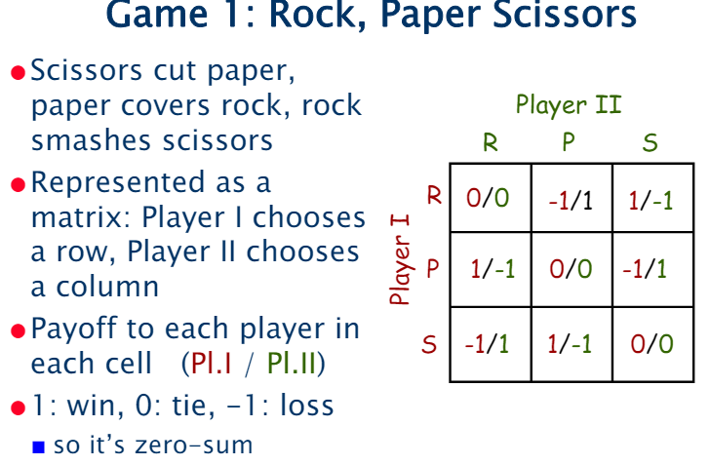

Slide 32
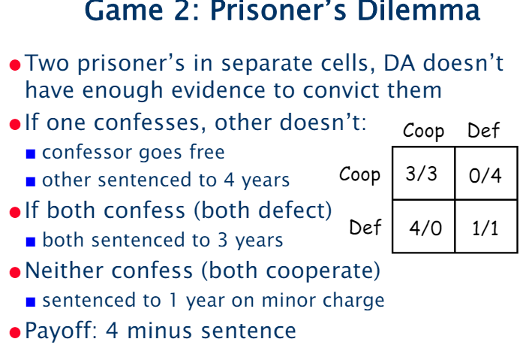

Slide 33
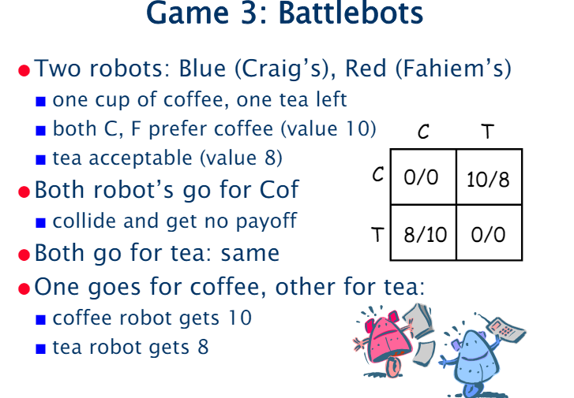

Slide 34
MiniMax Algorithm
Mini-max algorithm is a recursive or backtracking algorithm which is used in decision-making and game theory. It provides an optimal move for the player assuming that opponent is also playing optimally.
It is designed to minimize the possible loss in a worst-case scenario (hence "min") and maximize the potential gain (therefore "max").
Mini-Max algorithm uses recursion to search through the game-tree.
Min-Max algorithm is mostly used for game playing in AI. Such as Chess, Checkers, tic-tac-toe, go, and various tow-players game. This Algorithm computes the minimax decision for the current state.
In this algorithm two players play the game, one is called MAX and other is called MIN.

Slide 35
Both the players fight it as the opponent player gets the minimum benefit while they get the maximum benefit.
Both Players of the game are opponent of each other, where MAX will select the maximized value and MIN will select the minimized value.
The minimax algorithm performs a depth-first search algorithm for the exploration of the complete game tree.
The minimax algorithm proceeds all the way down to the terminal node of the tree, then backtrack the tree as the recursion.

Slide 36
Working of Min-Max Algorithm
The working of the minimax algorithm can be easily described using an example. Below we have taken an example of game-tree which is representing the two-player game.
In this example, there are two players one is called Maximizer and other is called Minimizer.
Maximizer will try to get the Maximum possible score, and Minimizer will try to get the minimum possible score.
This algorithm applies DFS, so in this game-tree, we have to go all the way through the leaves to reach the terminal nodes.
At the terminal node, the terminal values are given so we will compare those value and backtrack the tree until the initial state occurs. Following are the main steps involved in solving the two-player game tree:

Slide 37
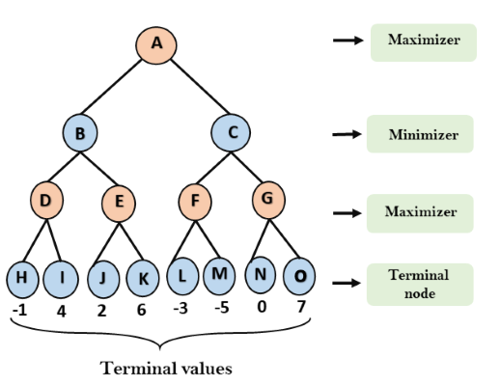
Step-1: In the first step, the algorithm generates the entire game-tree and apply the utility function to get the utility values for the terminal states. In the below tree diagram, let's take A is the initial state of the tree. Suppose maximizer takes first turn which has worst-case initial value =- infinity, and minimizer will take next turn which has worst-case initial value = +infinity.

Slide 38
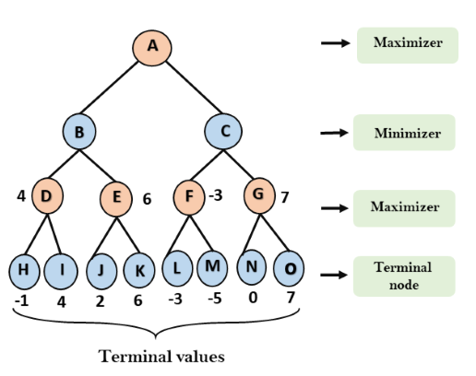
Step 2: Now, first we find the utilities value for the Maximizer, its initial value is -∞, so we will compare each value in terminal state with initial value of Maximizer and determines the higher nodes values. It will find the maximum among the all.
For node D max(-1,- -∞) => max(-1,4)= 4
For Node E max(2, -∞) => max(2, 6)= 6
For Node F max(-3, -∞) => max(-3,-5) = -3
For node G max(0, -∞) = max(0, 7) = 7

Slide 39
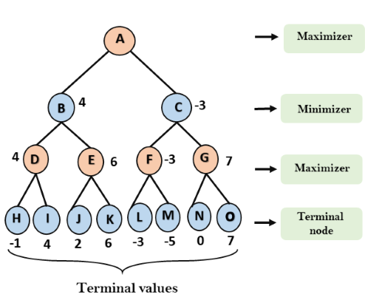
Step 3: In the next step, it's a turn for minimizer, so it will compare all nodes value with +∞, and will find the 3rd layer node values.
For node B= min(4,6) = 4
For node C= min (-3, 7) = -3

Slide 40
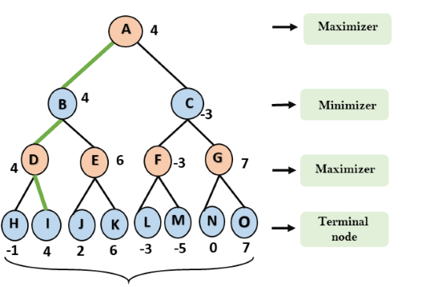
Step 4: Now it's a turn for Maximizer, and it will again choose the maximum of all nodes value and find the maximum value for the root node. In this game tree, there are only 4 layers, hence we reach immediately to the root node, but in real games, there will be more than 4 layers.
For node A max(4, -3)= 4
That was the complete workflow of the minimax two player game.

Slide 41
Advantages of Mini-Max algorithm
Complete- Min-Max algorithm is Complete. It will definitely find a solution (if exist), in the finite search tree.
Optimal- Min-Max algorithm is optimal if both opponents are playing optimally.
Time complexity- As it performs DFS for the game-tree, so the time complexity of Min-Max algorithm is O(b^{m}), where b is branching factor of the game-tree, and m is the maximum depth of the tree.
Space Complexity- Space complexity of Mini-max algorithm is also similar to DFS which is O(bm).

Slide 42
Disadvantages of Mini-Max algorithm
Computational Cost:
The algorithm's time complexity grows exponentially with the game tree's depth and branching factor, making it impractical for complex games like Chess or Go.
Memory Requirement:
Exploring the entire game tree can require significant memory, especially for games with a large number of possible moves.
Need for Heuristic Evaluation:
For complex games, it's often necessary to use a heuristic evaluation function to estimate the value of different game states, which can introduce inaccuracies.
Alpha-Beta Pruning:
To overcome the computational limitations, Alpha-Beta Pruning is often used, which reduces the search space by eliminating branches that cannot lead to a better move.

Slide 43
AlphaBeta Algorithm
Alpha-beta pruning is a modified version of the minimax algorithm. It is an optimization technique for the minimax algorithm.
As we have seen in the minimax search algorithm that the number of game states it has to examine are exponential in depth of the tree. Since we cannot eliminate the exponent, but we can cut it to half.
Hence there is a technique by which without checking each node of the game tree we can compute the correct minimax decision, and this technique is called pruning. This involves two threshold parameter Alpha and beta for future expansion, so it is called alpha-beta pruning. It is also called as Alpha-Beta Algorithm.
Alpha-beta pruning can be applied at any depth of a tree, and sometimes it not only prune the tree leaves but also entire sub-tree.

Slide 44
The two-parameter can be defined as:
Alpha: The best (highest-value) choice we have found so far at any point along the path of Maximizer. The initial value of alpha is -∞.
Beta: The best (lowest-value) choice we have found so far at any point along the path of Minimizer. The initial value of beta is +∞.
The Alpha-beta pruning to a standard minimax algorithm returns the same move as the standard algorithm does, but it removes all the nodes which are not really affecting the final decision but making algorithm slow. Hence by pruning these nodes, it makes the algorithm fast.

Slide 45
Key points about alpha-beta pruning
The Max player will only update the value of alpha.
The Min player will only update the value of beta.
While backtracking the tree, the node values will be passed to upper nodes instead of values of alpha and beta.
We will only pass the alpha, beta values to the child nodes.

Slide 46
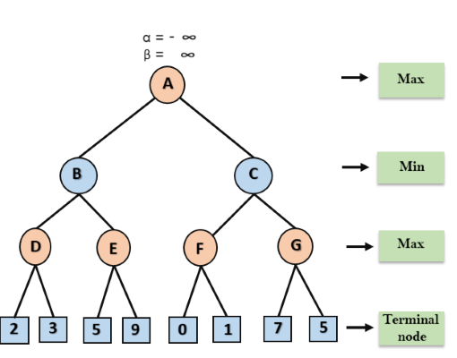
Step 1: At the first step the, Max player will start first move from node A where α= -∞ and β= +∞, these value of alpha and beta passed down to node B where again α= -∞ and β= +∞, and Node B passes the same value to its child D.

Slide 47
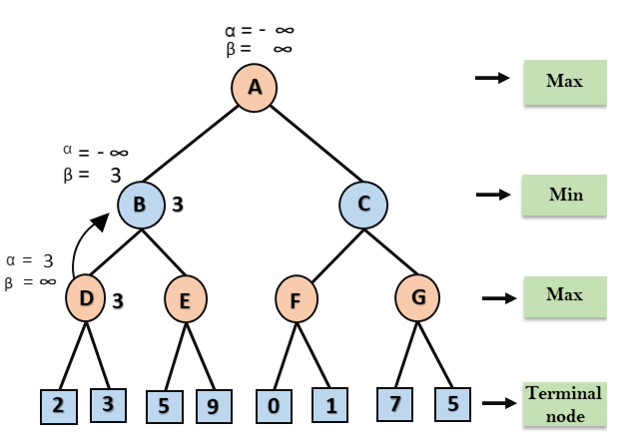
Step 2: At Node D, the value of α will be calculated as its turn for Max. The value of α is compared with firstly 2 and then 3, and the max (2, 3) = 3 will be the value of α at node D and node value will also 3.
Step 3: Now algorithm backtrack to node B, where the value of β will change as this is a turn of Min, Now β= +∞, will compare with the available subsequent nodes value, i.e. min (∞, 3) = 3, hence at node B now α= -∞, and β= 3.
In the next step, algorithm traverse the next successor of Node B which is node E, and the values of α= -∞, and β= 3 will also be passed.

Slide 48
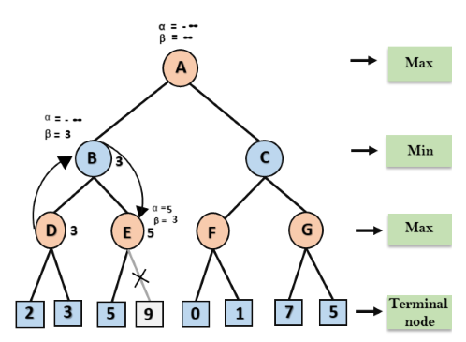
Step 4: At node E, Max will take its turn, and the value of alpha will change. The current value of alpha will be compared with 5, so max (-∞, 5) = 5, hence at node E α= 5 and β= 3, where α>=β, so the right successor of E will be pruned, and algorithm will not traverse it, and the value at node E will be 5.

Slide 49
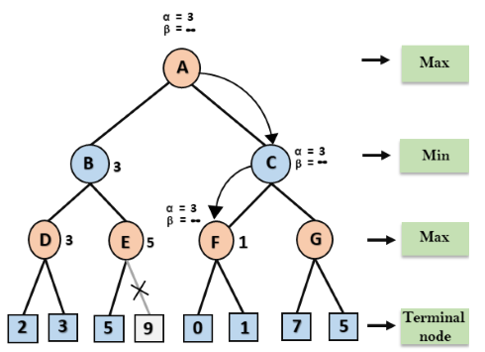
Step 5: At next step, algorithm again backtrack the tree, from node B to node A. At node A, the value of alpha will be changed the maximum available value is 3 as max (-∞, 3)= 3, and β= +∞, these two values now passes to right successor of A which is Node C.
At node C, α=3 and β= +∞, and the same values will be passed on to node F.
Step 6: At node F, again the value of α will be compared with left child which is 0, and max(3,0)= 3, and then compared with right child which is 1, and max(3,1)= 3 still α remains 3, but the node value of F will become 1.

Slide 50
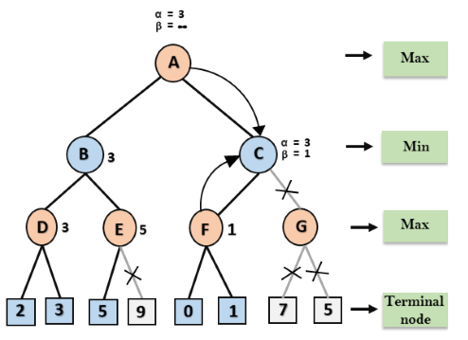
Step 7: Node F returns the node value 1 to node C, at C α= 3 and β= +∞, here the value of beta will be changed, it will compare with 1 so min (∞, 1) = 1. Now at C, α=3 and β= 1, and again it satisfies the condition α>=β, so the next child of C which is G will be pruned, and the algorithm will not compute the entire sub-tree G.

Slide 51
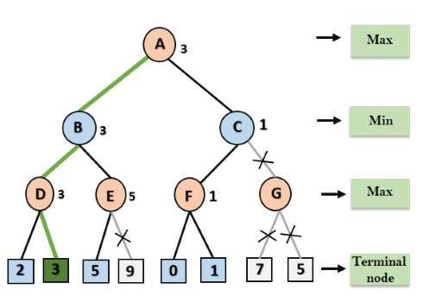
Step 8: C now returns the value of 1 to A here the best value for A is max (3, 1) = 3. Following is the final game tree which is the showing the nodes which are computed and nodes which has never computed. Hence the optimal value for the maximizer is 3 for this example.

Slide 52
Rules to find good ordering:
Following are some rules to find good ordering in alpha-beta pruning:
Occur the best move from the shallowest node.
Order the nodes in the tree such that the best nodes are checked first.
Use domain knowledge while finding the best move. Ex: for Chess, try order: captures first, then threats, then forward moves, backward moves.
We can bookkeep the states, as there is a possibility that states may repeat.

Slide 53
Example of Alpha-Beta Pruning
Consider a simple game tree where the branching factor is 2 and the depth is 3.
Start at the root (Max node). Initialize alpha to -∞ and beta to ∞.
Traverse to the first child (Min node) and evaluate its children (Max nodes).
For each Max node, traverse and evaluate its children (leaf nodes). Update alpha and beta accordingly.
Prune branches where alpha ≥ beta for Max nodes or beta ≤ alpha for Min nodes.

Slide 54
Advantages of Alpha-Beta Pruning
Efficiency: Alpha-beta pruning significantly reduces the number of nodes evaluated compared to the basic minimax algorithm, making the search process faster.
Optimality: Despite pruning, alpha-beta pruning does not affect the final decision; it still guarantees finding the optimal move.
Limitations of Alpha-Beta Pruning
Complexity: While it reduces the number of evaluations, the complexity can still be high for very large game trees.
Heuristic Dependency: The effectiveness of alpha-beta pruning can be highly dependent on the order in which nodes are evaluated. Good heuristic functions or move ordering can greatly enhance its performance.

Slide 55
Applications of Alpha-Beta Pruning
Alpha-Beta pruning is widely used in AI applications for two-player games such as:
Chess: Enhances the efficiency of chess engines, allowing them to evaluate deeper moves within time constraints.
Checkers: Optimizes move evaluation in checkers, making AI opponents more challenging.
Othello: Improves decision-making processes in Othello, leading to stronger AI strategies.

Slide 56
Advantages and limitations of search algorithms in AI
An approach that is methodical and well-organized: Search algorithms offer a structured way of quickly looking through enormous volumes of data, ensuring a methodical retrieval procedure.
Effective and precise retrieval: These algorithms make it possible to identify pertinent information quickly, enhancing the effectiveness and precision of information retrieval.
Handling complex search spaces: Search algorithms have the ability to handle complex search spaces, which enables them to travel through complex data structures or issue domains.
Adaptability to different challenges: Search algorithms are flexible and adaptable in numerous AI disciplines since they may be used to solve different kinds of problems.

Slide 57
AI search algorithm limitations
Performance problems with overly large or complex search spaces: When the search space is too big or complicated, search algorithms may run into performance problems, which might slow down retrieval or demand more computation.
Dependence on heuristics and input data quality: The effectiveness of the search results is significantly influenced by the precision of the used heuristics and the input data quality. The performance of search algorithms might be impacted by inaccurate or lacking data.
Non-guarantee of optimal solutions: In dynamic or incomplete search spaces, where the best solution might not be recognizable within the current limitations, search algorithms may not always guarantee finding the optimal solution.

Slide 58
Applications of search algorithms in AI
Applications for search algorithms can be found throughout several AI fields, including:
Natural language processing: Search algorithms are used for information extraction, query resolution, sentiment analysis, and other language processing tasks in natural language using AI.
Image recognition: These algorithms help in the search for pertinent photos using user queries or matching visual cues.
Recommendation systems: Search engines make personalized suggestions possible by matching user preferences with products that are appropriate.
Robotics: To ensure effective exploration and effective mobility, search algorithms are essential to robot path planning and navigation.
Data mining: These methods make it easier to do tasks like grouping, classification, & anomaly detection by extracting useful insights and patterns from vast datasets.

Slide 59
Chess, Go and Backgammon
Refer
https://www.codeproject.com/Articles/5300469/Backgammon-Artificial-Intelligence
https://www.codeproject.com/Articles/5300469/Backgammon-Artificial-Intelligence
https://www.youtube.com/watch?v=wDh4eCPk0Qo

